Slide 1
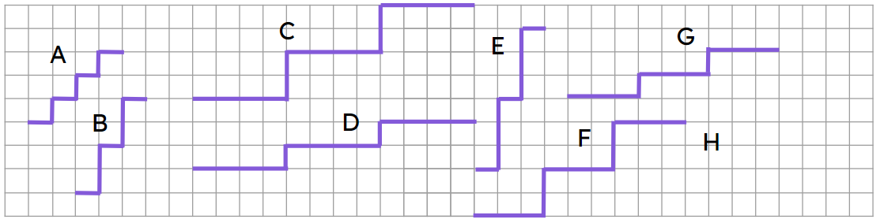
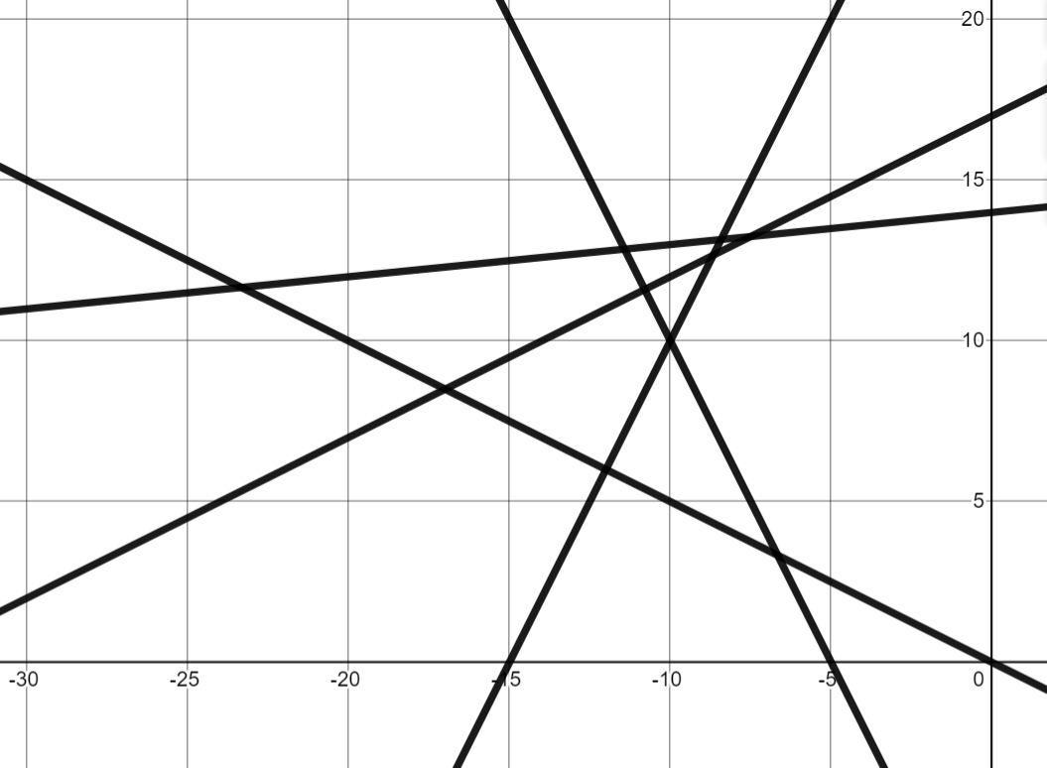
Positive rate of change from a graph
Task A: Defining gradient
1)
a) Put these steps in order from steepest to gentlest.
b) Draw staircase H so it is the steepest staircase.
c) Another set of steps join point P to point Q. Where would these steps go in order of steepness?
× Q
× P
2) Which lines have a positive gradient?
3) Which tables of values show a relationship which will have positive gradient when plotted?
C
D
E
a)
b)
c)
x | 0 | 1 | 2 | 3
y | 3 | 5 | 7 | 9
B
A
x | −2 | −1 | 0 | 1
y | 12 | 8 | 4 | 0
x | −8 | −7 | −6 | −5
y | −8 | −5 | −2 | 1

Slide 2
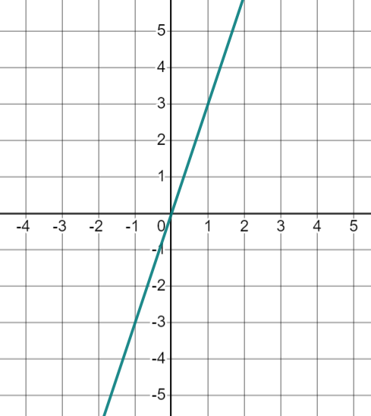
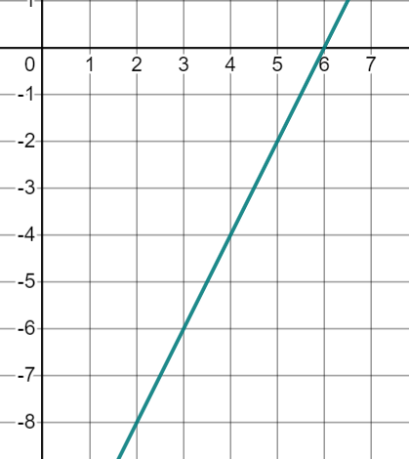
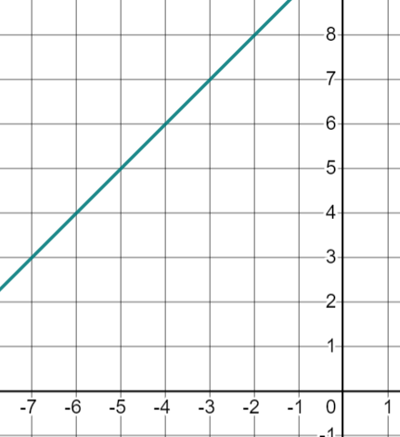
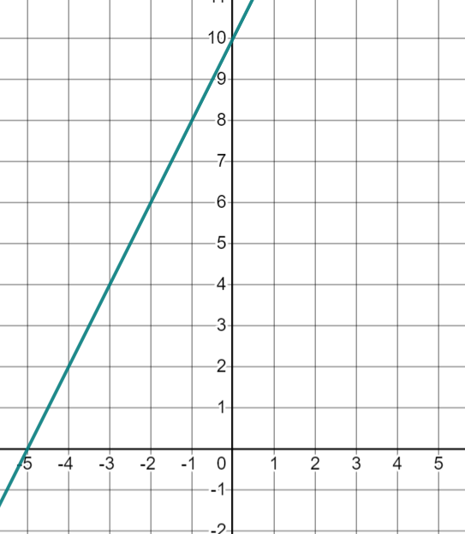
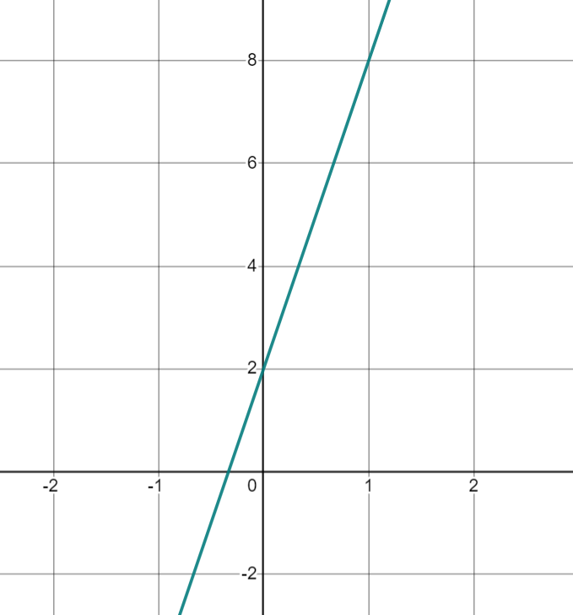
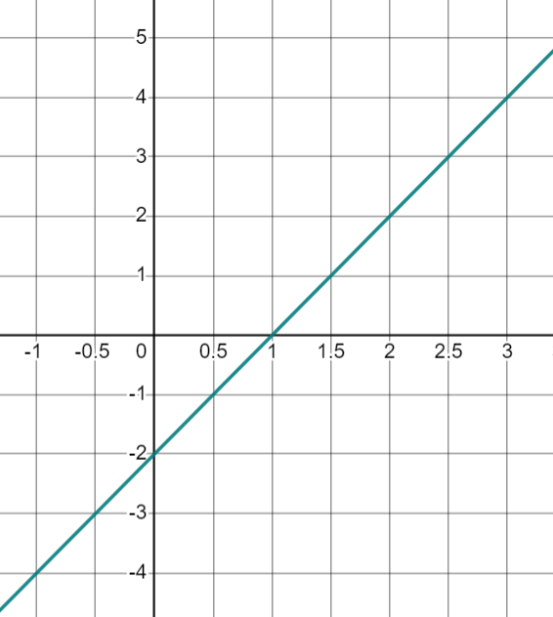
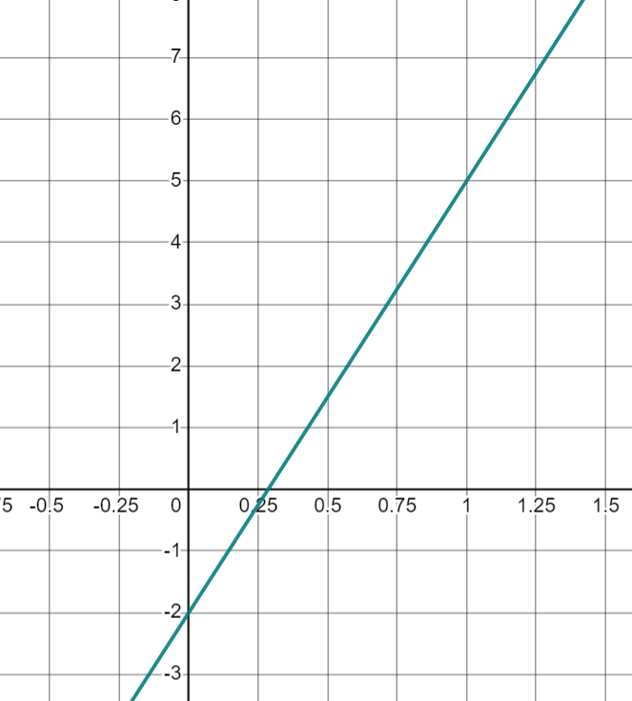
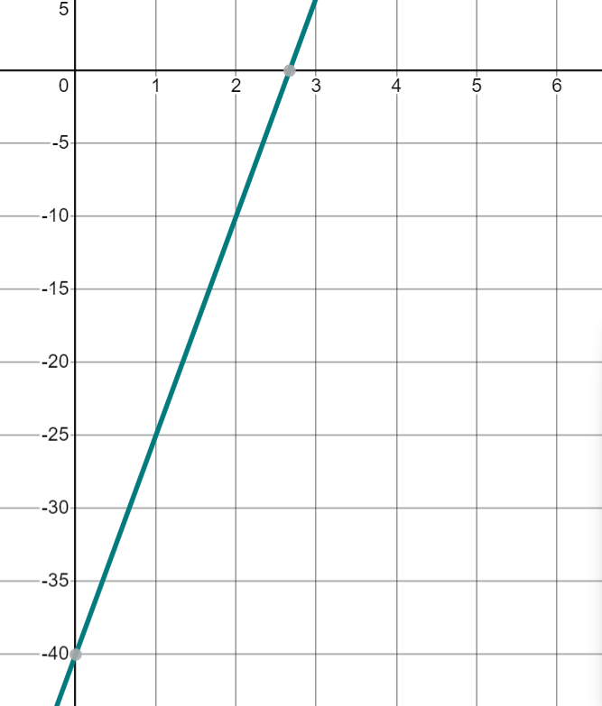
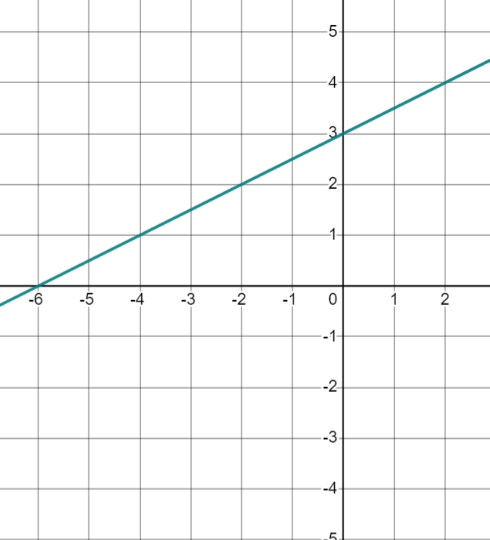
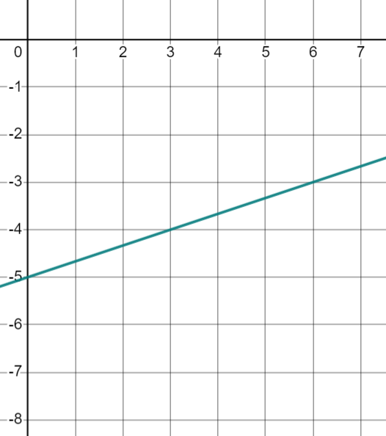
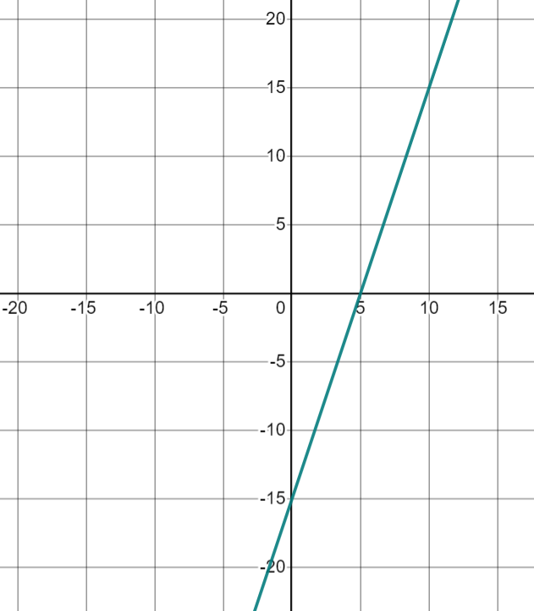
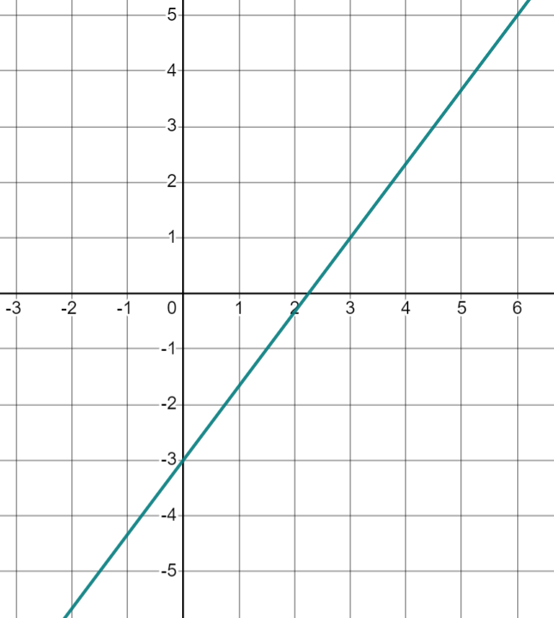
Positive rate of change from a graph
Task B: Calculating positive gradients from graphs
1) Find the gradient of each line You can draw a ratio table to help you.
a) | b) | c) | d)
e) | f)
g) | h)
i) | j) | k) | l)
Mathematics in Education and Industry
v2.2

